Slide 1
Determination of Heat Of Neutralization by using strong acid and base

Slide 2
What is heat of neutralization
It the heat energy released when one mole of water is formed from the neutralization between one mole of hydrogen ions, H+ from an acid and one mole of hydroxide ions, OH- from an alkali.
Energy change = mc θ In which,
m = the mass of the aqueous reaction mixture c = the specific heat capacity of the aqueous reaction mixture θ = the change in temperature

Slide 3
Procedure
${50 cm}^{3}$ of 1.0 mol/ ${ dm}^{3}$sodium hydroxide is measured using a 100 ml measuring cylinder and poured into a pre weighed calorimeter.
The initial temperature of the sodium hydroxide is determined using a thermometer.
The measuring cylinder is washed with water and then rinsed with the hydrochloric acid solution.
${50 cm}^{3}$ of 1.0 mol/ ${ dm}^{3}$hydrochloric acid is measured using a 100 ml measuring cylinder. Its initial temperature is recorded.
The HCl solution is then poured into the NaOH solution.
The mixture is stirred and the maximum temperature attained is recorded.
A graph is plotted between time and temperature and temp. rise is calculated from it.

Slide 4
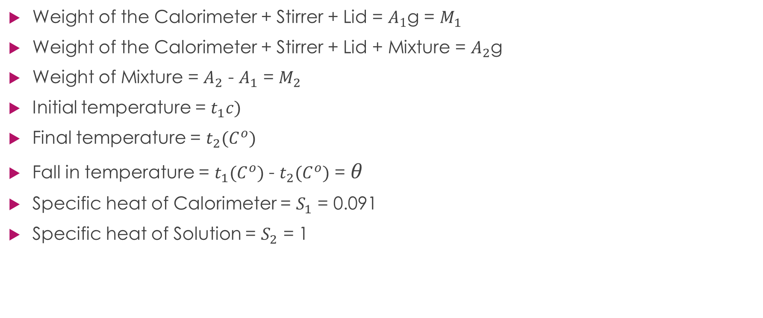
Calculations
Weight of the Calorimeter + Stirrer + Lid = $A_{1}$g = $M_{1}$
Weight of the Calorimeter + Stirrer + Lid + Mixture = $A_{2}$g
Weight of Mixture = $A_{2}$ - $A_{1}$ = $M_{2}$
Initial temperature = $t_{1}c)$
Final temperature = $t_{2}{(C}^{o})$
Fall in temperature = $t_{1}{(C}^{o})$ - $t_{2}{(C}^{o})$ = $θ$
Specific heat of Calorimeter = $S_{1}$ = 0.091
Specific heat of Solution = $S_{2}$ = 1

Slide 5
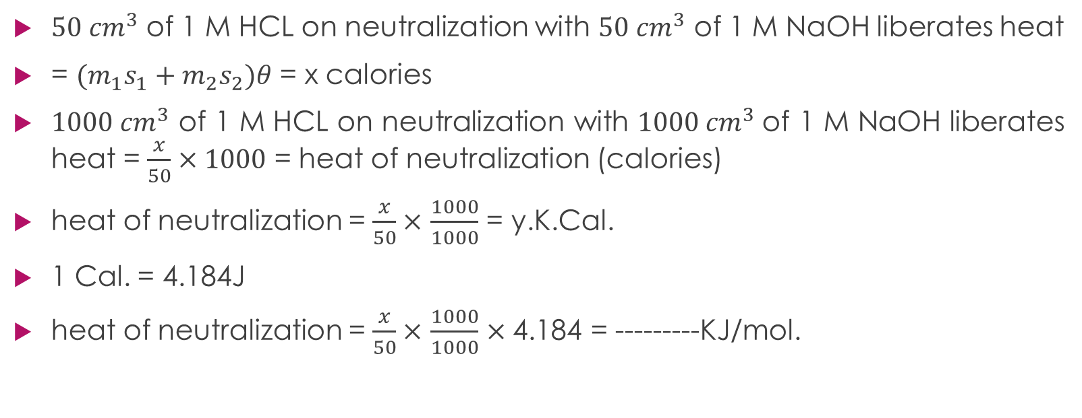
Calculations
${50 cm}^{3}$ of 1 M HCL on neutralization with ${50 cm}^{3}$ of 1 M NaOH liberates heat
= $(m_{1}s_{1}+m_{2}s_{2})θ$ = x calories
${1000 cm}^{3}$ of 1 M HCL on neutralization with ${1000 cm}^{3}$of 1 M NaOH liberates heat = $\frac{x}{50}×1000$ = heat of neutralization (calories)
heat of neutralization = $\frac{x}{50}×$ $\frac{1000}{1000}$ = y.K.Cal.
1 Cal. = 4.184J
heat of neutralization = $\frac{x}{50}×$ $\frac{1000}{1000}$ $×\text{4.184}$ = ---------KJ/mol.

Slide 6
Result discussion
strong acid and a strong alkali ionizes completely in water. HCl(aq) → $H^{+}$(aq) + ${Cl}^{−}$(aq) NaOH(aq) → ${Na}^{+}$(aq) + ${OH}^{−}$(aq) When these solutions are added together the only change that occurs is the formation of water molecules. ${Na}^{+}$(aq) + ${OH}^{−}$(aq) + $H^{+}$(aq) + ${Cl}^{−}$(aq) → NaCl(aq) + $H_{2}O$(l) Hence the heat of neutralization is the heat released from the formation of 1 mole of water and its value is approximately 57.4 kJ ${mol}^{−}$. ${OH}^{−}$(aq) + $H^{+}$(aq) → $H_{2}O$(l) ∆H= -57.4 kJ ${mol}^{−}$ Hence the heat of neutralization of any strong acid and strong alkali is the same. For example
${Na}^{+}$(aq) + ${OH}^{−}$(aq) + $H^{+}$(aq)+ ${NO}_{3}^{−}$(aq) → ${NaNO}_{3}$(aq) + $H_{2}O$(l) ∆H= -57.4 kJ ${mol}^{−}$

Slide 7
Result discussion
The heat of neutralization involving a weak acid and a weak alkali However when weak acids or alkalis are involved, the heat of neutralization is lower than 57.4 kJ ${mol}^{−}$. These weak acids or alkalis are partially dissociated in water. Some energy is needed to break the -O-H bonds to release the hydrogen ions or the hydroxide ions before they can react. Thus the net heat change will be less than 57.4 KJ ${mol}^{−}$. For example the heat of neutralization of ethanoic acid and sodium hydroxide is only 54 kJ ${mol}^{−}$

Slide 8
Determine the heat of solution of KNO3

Slide 9
What is heat of solution?
The heat evolved or absorbed when a substance dissolves
Specifically it is the amount involved when one mole or sometimes one gram dissolves in a large excess of solvent.
Generally heat of solution is expressed as,
ΔH_{water} = mass _{water} × ΔT_{water} × specific heat _{water}
Where,
ΔH = heat change
mass water = sample mass
ΔT = temperature difference
Specific heat = 0.004184 kJ/g∘C.

Slide 10
Procedure
Stirrer and calorimeter are washed and weighed.
100 ml of water is added in the calorimeter and temperature is noted using a thermometer.
In this water pre weighed quantity of KNO3 is added.
The mixture is stirred and the fall of temperature is recorded.
A graph is plotted between temp and time and calculation are made.

Slide 11
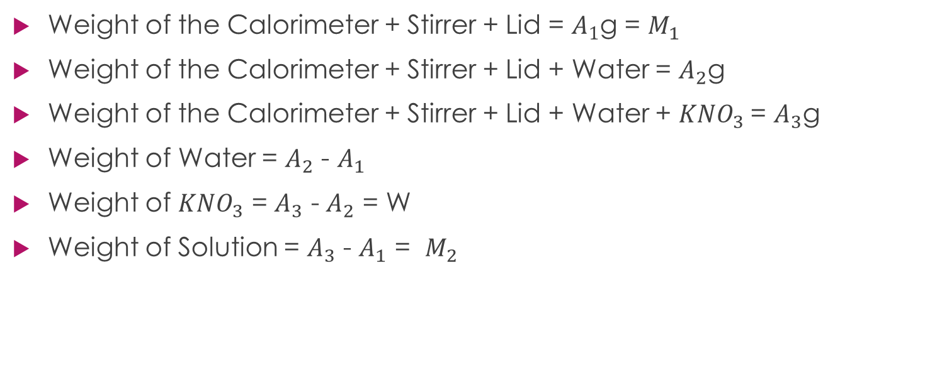
Calculations
Weight of the Calorimeter + Stirrer + Lid = $A_{1}$g = $M_{1}$
Weight of the Calorimeter + Stirrer + Lid + Water = $A_{2}$g
Weight of the Calorimeter + Stirrer + Lid + Water + ${KNO}_{3}$= $A_{3}$g
Weight of Water = $A_{2}$ - $A_{1}$
Weight of ${KNO}_{3}$ = $A_{3}$ - $A_{2}$ = W
Weight of Solution = $A_{3}$ - $A_{1}$ = $M_{2}$

Slide 12
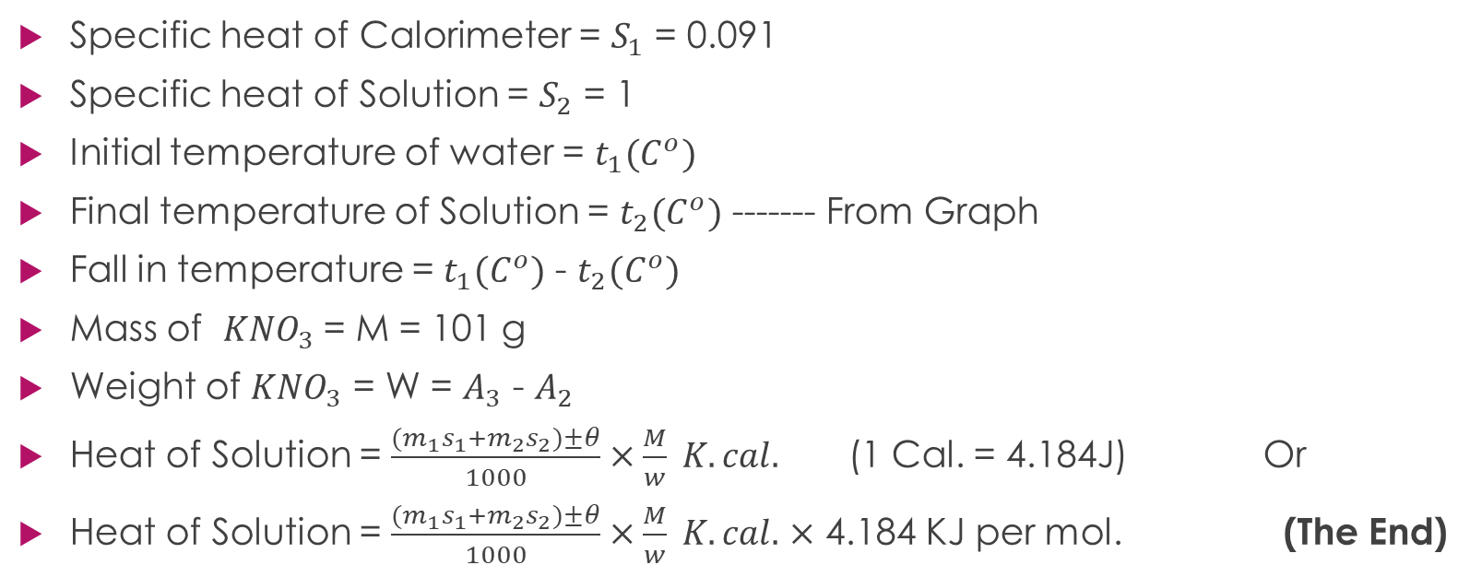
Calculations
Specific heat of Calorimeter = $S_{1}$ = 0.091
Specific heat of Solution = $S_{2}$ = 1
Initial temperature of water = $t_{1}{(C}^{o})$
Final temperature of Solution = $t_{2}{(C}^{o})$ ------- From Graph
Fall in temperature = $t_{1}{(C}^{o})$ - $t_{2}{(C}^{o})$
Mass of ${KNO}_{3}$= M = 101 g
Weight of ${KNO}_{3}$ = W = $A_{3}$ - $A_{2}$
Heat of Solution = $\frac{(m_{1}s_{1}+m_{2}s_{2})±θ}{1000}×\frac{M}{w} K.cal.$ (1 Cal. = 4.184J) Or
Heat of Solution = $\frac{(m_{1}s_{1}+m_{2}s_{2})±θ}{1000}×\frac{M}{w} K.cal.$ $×$ 4.184 KJ per mol. (The End)

